Slide 1

Y. Lakshmi Prasad
Introduction to
Clustering

Slide 2
Objectives
What is Clustering?
Checking Clustering Tendency
Find Optimal Number of Clusters
Clustering Methodology
Cluster Profiling
Limitations of Clustering
Clustering Applications
Use case of Clustering

Slide 3
Supervised learning vs. unsupervised learning
Supervised Learning
Goal: To predict a value based on given data.
Output – well defined (the target function)
Experience – training data provided
Performance – Error/Accuracy on the task
Unsupervised Learning
Goal: To find some kind of shape/ structure in the data.
Output – vaguely defined
No Experience
No Performance (there are some evaluations metrics)

Slide 4
What is Clustering?
Clustering = Grouping “Similar” things together!
Discover & Understand structure in data
Summarize data points by their “Cluster center”
Compress data variability into “representative vectors”

Slide 5
Clustering Tendency
Whether the Data contains inherent Grouping Structure?
Cluster-ability Assessment Methods:
1. Spatial Histogram Method
2. Distance Distribution
3. Hopkins Statistic

Slide 6
Spatial Histogram Method
Contrast the D-dimensional histogram of the input dataset with the histogram generated from random samples.
Dataset D is clusterable if the distributions of two histograms are rather different.
In this method, we divide each dimension into Equi-width bins, count how many points lie in each cell and obtain EPMF (Emperical Joint Probability Mass Function), then do the same for randomly sampled data.
Compute how much they differ using Kullback-Leibler (KL) divergence value.

Slide 7
Clustering Tendency
2. Distance Distribution: Compare the pair-wise point distance from the data with those from the randomly generated samples.
3. Hopkins Statistic: A sparse sampling test for spatial randomness.
A value close to 1 tends to indicate the data is highly clustered, random data will tend to result in values around 0.5, and uniformly distributed data will tend to result in values close to 0.

Slide 8
Clustering Methods
Clustering Methods
Partitional
Hierarchical
Hard
Soft
Agglomerative
(Bottom-Up)
Divisive
(Top-Down)
Key to Clustering is how we define “Distance” or “Similarity” between two data points

Slide 9
Clustering Techniques
Partitioning Method: K-Means Clustering
Hierarchical Method: BIRCH (balanced iterative reducing and clustering using hierarchies)
Density-based Method: Density-based spatial clustering of applications with noise (DBSCAN)
Grid-Based Method: Statistical Information Grid-(STING) based clustering
Model-Based Method: Expectation-Maximization (EM)algorithm

Slide 10
K-means clustering
K-means is a Partitional clustering algorithm as it partitions the given data into k-clusters.
Each cluster has a cluster center, called centroid. k is specified by the user

Slide 11
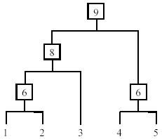
Hierarchical Clustering
Decomposes data objects into a several levels of nested partitioning (tree of clusters).
A clustering of the data objects is obtained by cutting the dendrogram at the desired level, then each connected component forms a cluster.

Slide 12
Agglomerative clustering
Assign each item to its own cluster, so that if you have N items, you now have N clusters, each containing just one item.
Merge most similar clusters into a single cluster, so that now you have one less cluster.
Compute distances (similarities) between the new cluster and each of the old clusters.
Repeat steps 2 and 3 until all items are clustered into a single cluster of size N.

Slide 13
DBSCAN Clustering
A cluster is defined as a connected dense component which can grow in any direction that density leads.
Arbitrary shaped clusters and good scalability
Clusters are defined as Density-Connected Sets
Density and connectivity are measured by local distribution of nearest neighbor
Target low dimensional spatial data

Slide 14
STING Clustering
The spatial area is divided into rectangular cells
There are several levels of cells corresponding to different levels of resolution

Slide 15
Expectation Maximization
A point belongs to a center in proportion to its Gaussian probability
Cluster centers are optimized to maximize the probability of all points (so they do not move as drastically as K-means)

Slide 16
Questions to Ask ourselves
1. What is the Objective Function?: Minimize aggregate the intra cluster distance.
2. What are the HyperParameters? – K, Distance, Linkage, No of Iterations etc..
3. What are the Parameters?- Mean, Centroid
4. How can we Regularize the Model?

Slide 17
What Exactly Are We Looking for?
The following questions need to be answered:
1. What kind of similarity are we looking for? Is it pattern or proximity?
2. How do we form the groups?
3. How many groups should we form?
4. What’s the interpretation of each cluster?
5. What’s the strategy related to each of these cluster?

Slide 18
How many Clusters?
What is the “Minimum” number of clusters we can have?
What is the “Maximum” number of clusters we can have?
How do we know the right number of clusters?
Business Driven Decision
I have budget for only 10 customer campaigns!
I can create only 20 FAQ sections in my manual!
I can have only 4 options in my menu system!
Machine Learning Driven Decision
COMPLEXITY vs. ACCURACY tradeoff
Minimum Description Length
ACCURACY
COMPLEXITY

Slide 19
Finding Optimal Number of Clusters
The optimal number of clusters is somehow subjective and depends on the method used for measuring similarities and the parameters used for partitioning.
1. Direct methods: consists of optimizing a criterion, such as the within cluster sums of squares or the average silhouette. The corresponding methods are named elbow(Scree Plot) and silhouette methods.
2. Statistical testing methods: consists of comparing evidence against null hypothesis. An example is the gap statistic.

Slide 20
Data Preparation
There are two steps we need to perform prior to doing the clustering:
1. Scaling
2. Weighting
Scaling is basically the concept of adjusting the values of the variables to take into account the fact that variables are measured on very different scales.

Slide 21
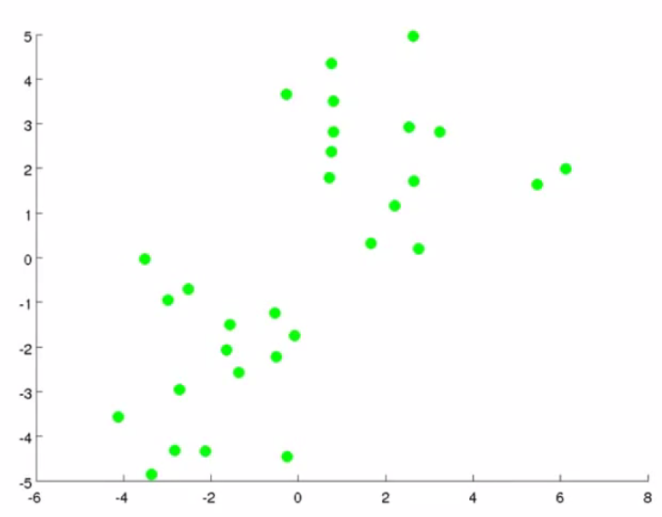
Data Points on 2D space

Slide 22
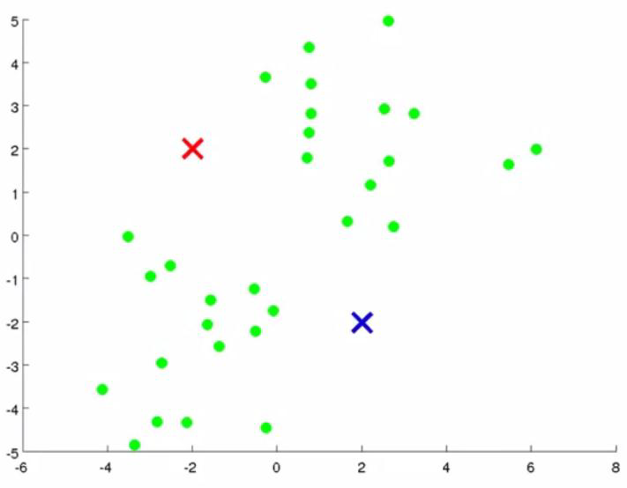
Random selection of seeds

Slide 23
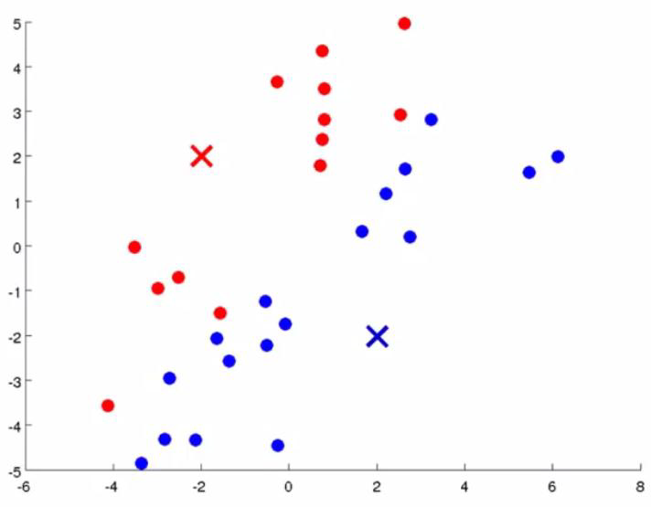
Assigning data points

Slide 24
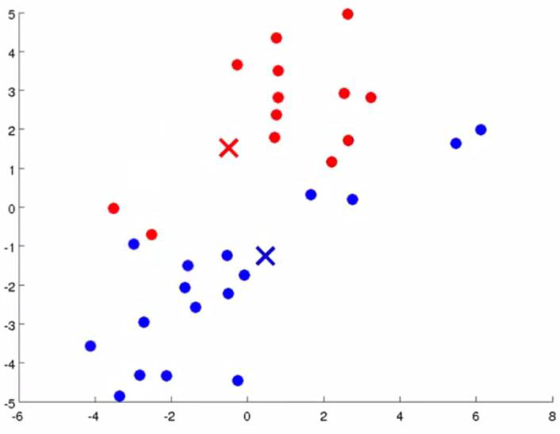
Calculate centroids

Slide 25
Re-assign data Points

Slide 26
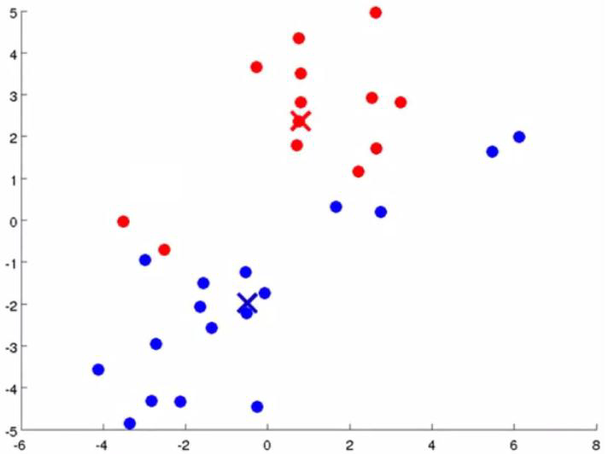
Re-calculate centroids

Slide 27
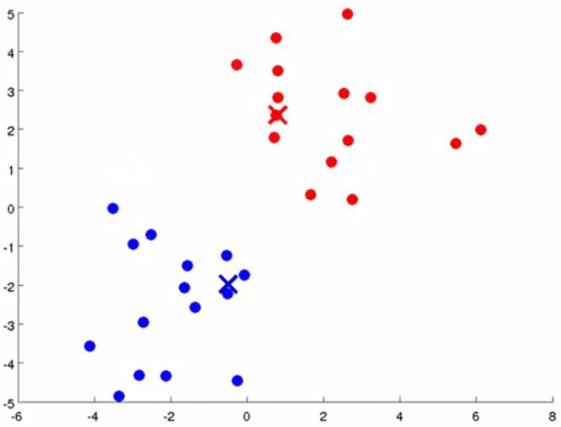
Re-assign data Points

Slide 28
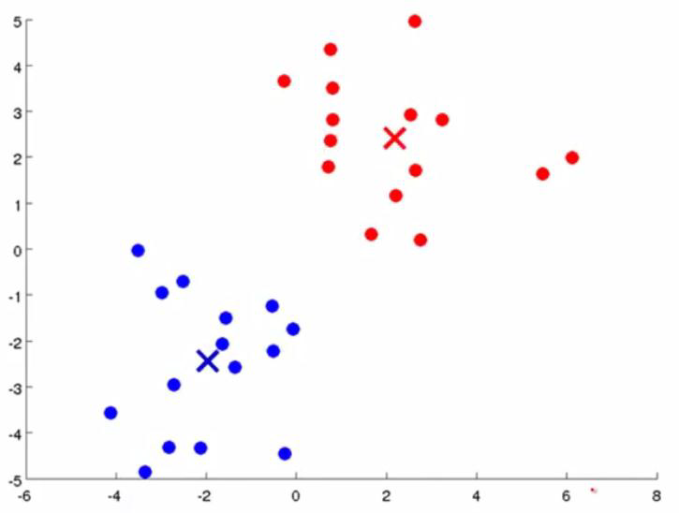
Stable Clusters formed

Slide 29
K – Means Algorithm
1. Identify Value of K, then assign the K
2. Assign K observations as seeds from the data
3. Assign each record to 1 of the K seeds based on proximity
4. Form the Initial Clusters
5. Calculates centroid for the new cluster
6. Assign centroids as new seeds
7.Form New Clusters
8. Recalculate Centroids
9. Continue this process till there is no movement of observations across clusters i.e. stable clusters are formed.

Slide 30
K-Means Algorithm
Let d be the distance measure between instances.
Select k random instances {s₁, s₂,… s_{k}} as seeds.
Until clustering converges or other stopping criterion:
For each instance x_{i}:
Assign x_{i} to the cluster c_{j} such that d(x_{i}, s_{j}) is minimal.
(Update the seeds to the centroid of each cluster)
For each cluster c_{j}
s_{j} = μ(c_{j})

Slide 31
Quality of Clusters
Intra-cluster cohesion (compactness): – Cohesion measures how near the data points in a cluster are to the cluster centroid.
Inter-cluster separation (isolation): – Separation means that different cluster centroids should be far away from one another.

Slide 32
Convergence criterion
When to stop?
When a fixed number of iterations is reached
When centroid positions do not change
Seed Choice
Results can vary based on random seed selection.
Try out multiple starting points

Slide 33
Stopping/convergence criterion
no (or minimum) re-assignments of data points to different clusters,
no (or minimum) change of centroids, or minimum decrease in the sum of squared error (SSE)
m_{j} is the centroid of cluster
C_{j} (the mean vector of all the data points in C_{j}),
dist(x, m_{j}) is the distance between data point x and centroid m_{j}.

Slide 34
Distance calculation
Euclidean: Euclidean distance is the "'ordinary' straight-line distance between two points in Euclidean space”.
The Manhattan distance is defined as "the distance between two points is the sum of the absolute differences of their Cartesian coordinates”.
Mahalanobis distance can be used to normalize the covariance matrix.
The Chebyshev distance can be used to measure the distance by considering only the most notable dimensions.
The Hamming distance algorithm can identify the difference between two strings.
The Haversine distance is used to measure the great-circle distances between two points on a sphere from the location.

Slide 35
Challenges of Clustering
Nice Clean Clusters
Density Variation
Not Clean Separation
Background Noise
Not Spherical data
Not Easily Separable

Slide 36
K-Means – Intuition

Slide 37
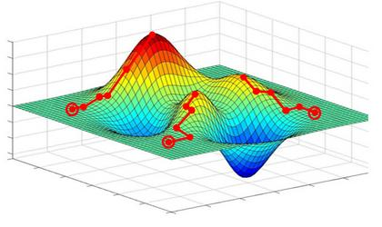
Reminder!
There are more than one “Local Optmias”
Depending on Initialization → Nearest Local Optima
No Guarantee of finding “Global Optima”
Clustering is a “Crazy” Optimization Problem
Initialization determines which local Optima

Slide 38
Dissimilarity/Distance Measure
Dissimilarity/Similarity metric: Similarity is expressed in terms of a distance function, which is typically metric: d (i, j)
The definitions of distance functions are usually very different for interval-scaled, boolean, categorical, ordinal and ratio variables.
Weights should be associated with different variables based on applications and data semantics. It is hard to define “similar enough” or “good enough”. The answer is typically highly subjective.

Slide 39
Measuring Distance
One of the central idea of the K means algorithm is to measure the distance between two points.
This is required in order to find the proximity of the points to the various seeds and proximity from each other.
How does the algorithm measure distance?
The first is to mark the coordinates of the two points (x1,y1), (x2,y2). Now the formula is simple geometric Pythagoras theorem.

Slide 40
Centroid, Radius & Diameter of a Cluster
Centroid: the “middle” of a cluster
Radius: square root of average distance from any point of the cluster to its centroid
Diameter: square root of average mean squared distance between all pairs of points in the cluster

Slide 41
Measuring the distance of two clusters
A few ways to measure distances of two clusters.
Single link
Complete link
Average link
Centroids

Slide 42
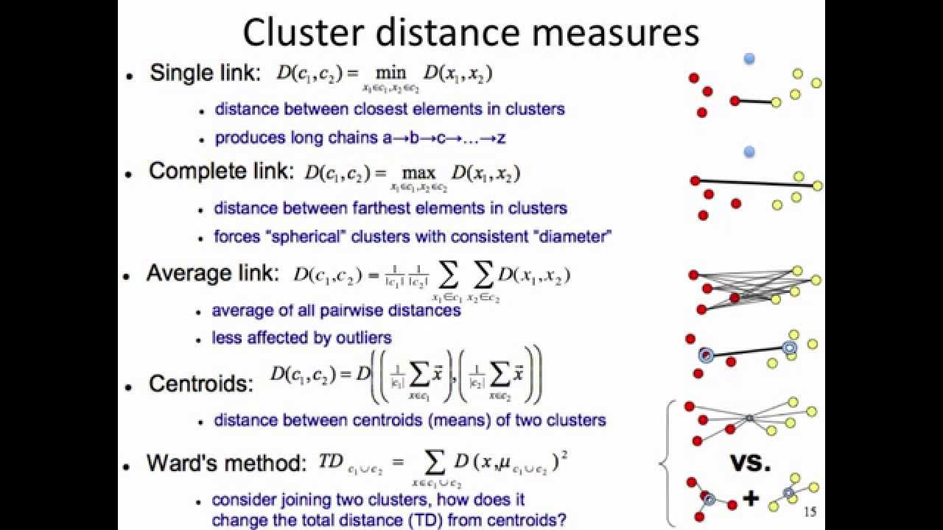
Linkage Methods

Slide 43
Metric and linkage
In order to decide which clusters should be combined (for agglomerative), or where a cluster should be split (for divisive), a measure of dissimilarity between sets of observations is required.

Slide 44
Metric and linkage
In most methods of hierarchical clustering, this is achieved by use of an appropriate metric (a measure of distance between pairs of observations), and a linkage criterion which specifies the dissimilarity of sets as a function of the pair-wise distances of observations in the sets.
Generally the distance metric is the Euclidean distance. As for linkages, there are single linkage (the shortest distance between two clusters), complete linkage (the longest distance), and average linkage (the average of all the distances between the two clusters).

Slide 45
K-means Effect of Initialization
Does the final solution depend on initialization?
RANDOM INITIALIZATION
Which of these is the best initialization? Why?
Is there a “deterministic” and “principled” cluster initialization?

Slide 46
Farthest First Point Initialization
Pick the FIRST point that is FARTHEST from the MEAN of the DATA CLOUD
Pick the THIRD point that is FARTHEST from the FIRST and SECOND
Pick the SECOND point that is FARTHEST from the FIRST

Slide 47
Farthest First Point Sampling
Pick the THIRD point that is FARTHEST from the FIRST and SECOND

Slide 48
Applications of clustering
1. Groups people of similar sizes together to make “small”, “medium” and “large” T-Shirts.
Tailor-made for each person: too expensive
One-size-fits-all: does not fit all.
2. Help marketers discover distinct groups in their customer bases, and then use this knowledge to develop targeted marketing programs

Slide 49
Applications of clustering
Example 3: Given a collection of text documents, we want to organize them according to their content similarities, To produce a topic hierarchy
Example 4: Insurance: Identifying groups of motor insurance policy holders with some interesting characteristics.
Example 5: City-planning: Identifying groups of houses according to their house type, value, and geographical location

Slide 50
Strengths of k-means
Simple: easy to understand and to implement
Efficient: Time complexity: O (tkn),
where n is the number of data points,
k is the number of clusters, and
t is the number of iterations.
Since both k and t are small. k-means is considered a linear algorithm.

Slide 51
Weaknesses of k-means
The algorithm is only applicable if the mean is defined.
For categorical data, k-mode - the centroid is represented by most frequent values.
The user needs to specify k.
The algorithm is sensitive to outliers
Outliers are data points that are very far away from other data points.
Outliers could be errors in the data recording or some special data points with very different values

Slide 52
Questions?

